Slide 1

Offline Course Package for a Database Systems Course
Ria Mae Borromeo and Joshze Rica Esguerra
University of the Philippines Open University
Notes:
Offline Course Package for a Database Systems Course

Slide 2

Introduction
Recently, remote learning for Database Systems courses (a core course in Computer Science) has become popular in educational and professional development institutions.
These courses are typically done over the Internet using Learning Management Systems (LMS).
While the Internet has enabled increased access to education, there are still remote areas and developing regions with limited access to the Internet.
Notes:
Recently, remote learning for Database Systems courses (a core course in Computer Science) has become popular in educational and professional development institutions.
These courses are typically done over the Internet using Learning Management Systems (LMS).
And they have been working really well.
As we all know, the Internet has enabled increased access to education but there are still remote areas and developing regions with limited access to the Internet.

Slide 3
Introduction
The Philippines ranks 68th (out of 120) countries in the 2021 Inclusive Internet Index, which gives an estimate of the extent that the Internet is accessible, affordable, and relevant to the population.
To not disadvantage learners in areas with limited Internet connectivity, there is a need to make online courses available offline.
Notes:
For instance, The Philippines ranks 68th (out of 120) countries in the 2021 Inclusive Internet Index, which gives an estimate of the extent that the Internet is accessible, affordable, and relevant to the population.

Slide 4
Existing Solutions
Extensions to Moodle
An offline web application using HTML5 that provides an offline interface for students to work offline then retrieve/submit activities from/to their institution’s Moodle LMS once they are online (Ijtihadie, 2010)
Extension to to enable Moodle to run in offline mode, allowing learners to perform activities offline and sync their progress to the Moodle server once a connection is restored (Ngom, 2012)
Notes:
Existing solutions to that problem involve extensions to moodle, an open source LMS that most of us are very familiar with, and moodle itself.

Slide 5
Existing Solutions
Extensions to Moodle
MOLEAP - an offline learning management system based on Moodle. The system can be executed by booting a USB or CD ROM drive. It also features an office suite, graphics editor, and multimedia player and the ability to enable two-way communication and updates when connected to the Internet (Hillier, 2017)

Slide 6
Existing Solutions
Moodle
The current version of Moodle allows offline access through the Moodle Mobile app. Once students download the entire course site, they can access the course contents in the Moodle Mobile app. When reconnected to the Internet, their assignment submissions and discussion forum posts are synced to the Moodle server.

Slide 7
While the Moodle Mobile app is an excellent option for offline access, it is still limited to Moodle users and mobile users.

Slide 8
Proposed Solution
An offline course package for a Database Systems course deployed as a client-side only web application. This can be used both in personal computers and mobile devices.
Once students secure a copy of the course package, they can create their profile, access lectures, take quizzes with automated feedback, track their course progress, and launch SQLite to practice SQL programming, even without an internet connection.

Slide 9
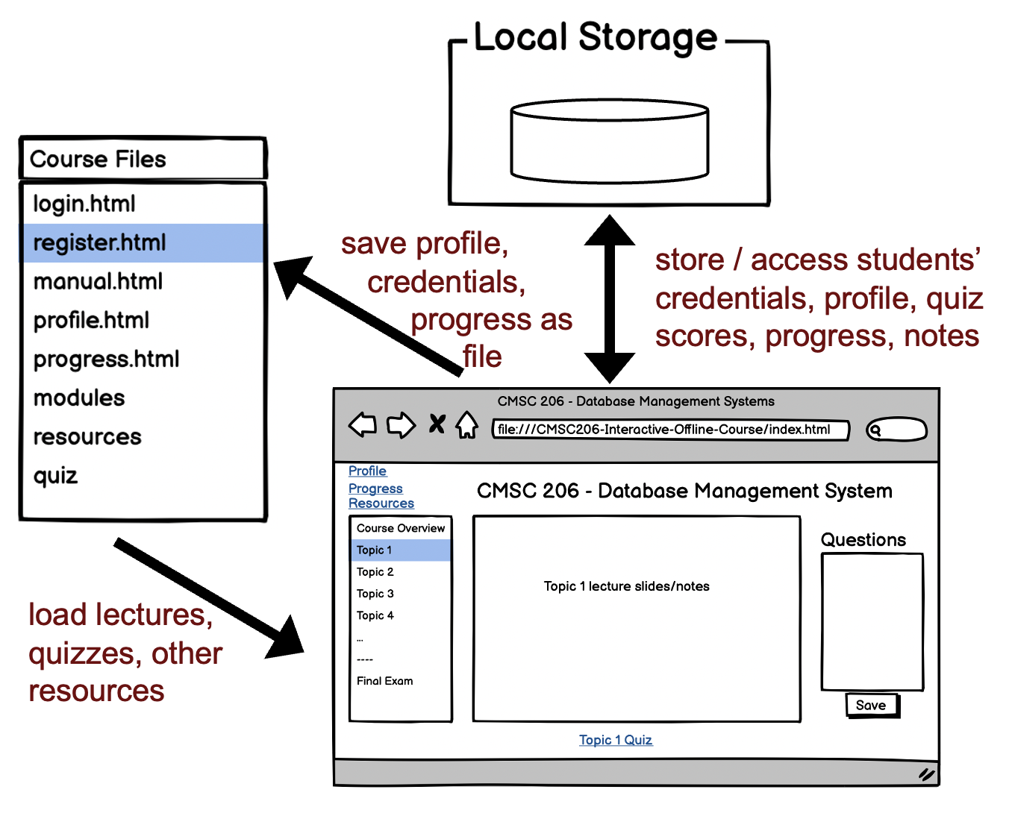
System Architecture

Slide 10
Demo
https://github.com/joshzes/CMSC206-Interactive-Offline-Course

Slide 11
Discussion
The course package addresses the need for an offline course package. While potentially useful, it is still pending evaluation.
Open issues:
Viewing of source codes
Couse materials licensing
Extending to other courses
Class communications

Slide 12
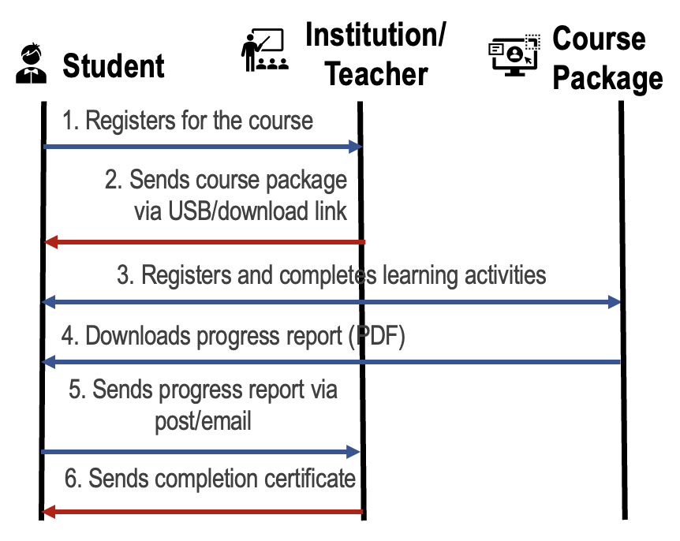
Future Work
Evaluate in an actual class
Distribute as MOOC
Create a generic version that can be used by any other courses
Offline MOOC Implementation Plan

Slide 13
Offline Course Package for a Database Systems Course
Ria Mae Borromeo and Joshze Rica Esguerra
University of the Philippines Open University
Notes:
Offline Course Package for a Database Systems Course

Slide 14
Thank you!
rhborromeo@up.edu.ph, jlesguerra2@up.edu.ph
https://github.com/joshzes/CMSC206-Interactive-Offline-Course

